Slide 1
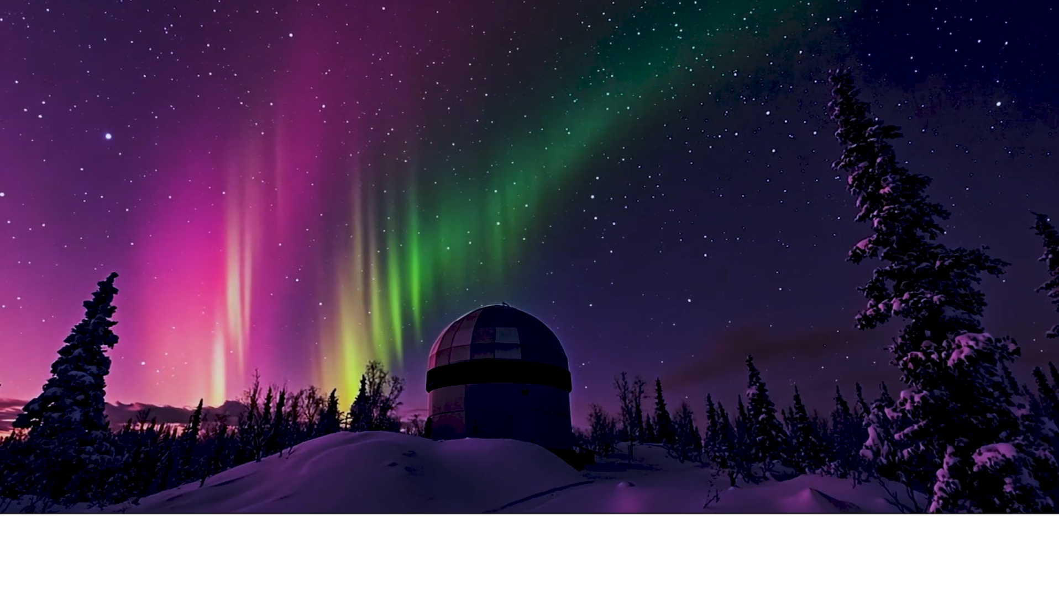

Announcing…

Slide 2

The Multi-platform Imaging Suite
for Windows/Mac/Linux/RPi
Pre-Release 0.9.0alpha

Slide 3
1.0 Overview

Slide 4

Questions?
www.galileo-imaging.com

